Slide 1
Attitudes and job satisfaction

Slide 2
What is attitude?
Attitudes are evaluative statements- either favourable or unfavourable- concerning objects, people or events.
They reflect how one feels about something (Robbins and Judge).

Slide 3
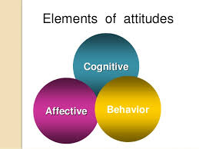
The three components of attitudes
Cognitive component
Affective component
Behavioural component

Slide 4
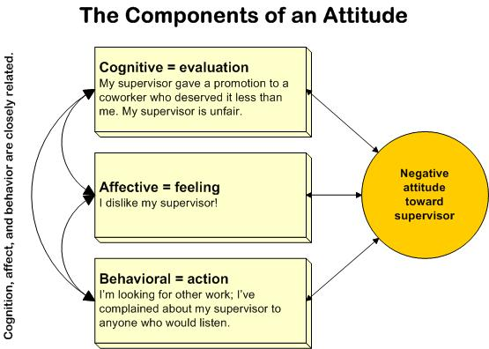

Slide 5
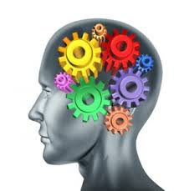
1) Cognitive component
It refers to how we think about someone or something
The cognitive component is the belief or opinion aspect of the attitude

Slide 6
2) Affective component
It is the emotional aspect of the attitude
It refers to how we feel about someone or something

Slide 7
3) Behavioural component
It is an intention to behave in a certain way toward someone or something
It refers to the tendency of a person to behave or act in a certain way.

Slide 8
Importance of attitudes in workplace
Employees’ attitudes have a profound impact on their behaviour
It is important to understand how attitudes are formed, how they affect job behaviour and how they can be changed

Slide 9
Major job related attitudes
Job related attitudes are the relatively lasting feelings, beliefs and behavioural tendencies that an employee has toward the various aspects of the job
Job involvement
Organizational commitment
Perceived organizational support
Employee engagement
Job satisfaction

Slide 10
Job involvement
The degree to which a person identifies with a job, actively participates in it and considers performance important to self worth

Slide 11
Characteristics of employees with job involvement
Identity- high level of belongingness to the organisation
Psychological empowerment- employees feel that they are doing a meaningful job and what they do makes a difference to the organisation
Participation- high growth needs and enjoy participating in decision making
High performance and low absenteeism- rarely late or absent

Slide 12
2. Organisational commitment
The degree to which an employee identifies with a particular organisation and its goals and wishes to maintain membership in the organisation

Slide 13
Employees with organisational commitment
Accept the values and goals of the organisation
Are willing to exert effort for the organisation
Have a strong desire to remain with the organisation

Slide 14
Research has found that
Higher productivity- modest positive relationship between organisational commitment and productivity
Lower absenteeism and turn over
Creativity suffers

Slide 15
Relationship between organisational commitment and other variables
Higher productivity
Lower absenteeism and turnover
Creativity (less creativity)
Moderate positive relationship
Negative relationship
positive relationship with low O.C.

Slide 16
Perceived organisational support
The degree to which employees believe an organisation values their contribution and cares about their well being

Slide 17
Employees perceive their organisation as supportive when:
The reward system in the organisation is fair
Participation in the decision making process
Managers are supportive and understanding

Slide 18
Employee engagement
An individual’s involvement with, satisfaction with and enthusiasm for the work he or she does.
Employees are very passionate about their work and have a deep connection with the company

Slide 19
Disengaged employees put time but not energy or attention into their work.

Slide 20
Employees develop high levels of engagement if their jobs:
Are important and meaningful
Allow easy access to resources and opportunities to learn new skills
Permit rewarding interactions with co workers and supervisors
Give clear guidelines
Allow control over performance
Are consistent with their identity and training

Slide 21
High levels of employee engagement results in
Higher levels of customer satisfaction
Sharp drop in customer grievances
More productivity and higher profits
Reduces employee turnover and lesser accidents at work

Slide 22
Are these job attitudes really distinct?
?

Slide 23
Managers’ classification of employees
Enthusiastic stayers
Reluctant stayers
Enthusiastic leavers
Reluctant leavers

Slide 24
Job satisfaction
A positive feeling about one’s job resulting from an evaluation of its characteristics

Slide 25
Measurement of job satisfaction
Single global rating
Facet rating
Overall level of job satisfaction is measured
Done by using one simple question like ‘ how satisfied are you in your work’?
It is measured on a five point scale
The employee has to select any number between 1 and 5
More sophisticated and lengthy
In this method,
The key elements of the job are identified (supervision, nature of work etc.)
Employee is then asked to rate his feelings for each of the job elements on a standardized scale
Researchers then add up the ratings on each of the facets to obtain the overall job satisfaction score.

Slide 26
Researchers consider both facet and global rating to be equally effective. Why?
The concept of job satisfaction is a broad one that even a single question will make the person understand what it means
It is possible that some important facets of job satisfaction are not included in the summation of the score

Slide 27
Advantages of the rating methods
Single global rating
Facet rating
It is not time consuming
It helps to identify the factors with which employees are dissatisfied so that they can take quick corrective measures

Slide 28
Determinants of job satisfaction
Three major determinants
Work itself
Pay
Personality

Slide 29
1) Work itself
High levels of job satisfaction when they enjoy the work
When the work is challenging and stimulating than routine
Greater satisfaction when there is feed back

Slide 30
2) Pay
For poor, pay has a strong relationship with job satisfaction
Once a comfortable living is reached, then pay is not very important

Slide 31
3) Personality
Individuals who are more happy are generally satisfied
Another personality factor that influences job satisfaction is core self evaluation
It refers to the person’s belief in their inner worth and competence.
People high on core self evaluation will be more satisfied in their jobs

Slide 32
The impact of job satisfaction
Both job satisfaction and dissatisfaction have a strong impact on the organisation

Slide 33
Exit-voice-loyalty-neglect model
According to the exit-voice-loyalty-neglect model dissatisfied employees react in certain ways
Constructively or destructively
Actively or passively
The response of the employee would be an outcome of these two dimensions
He may respond in the following ways

Slide 34
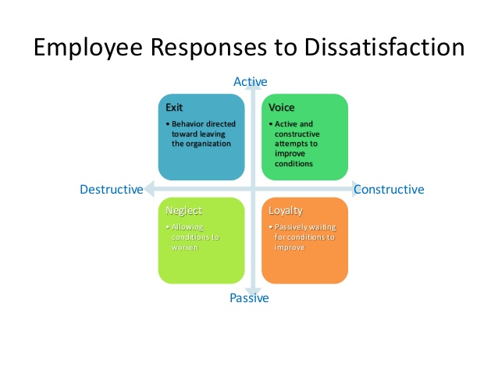
Exit-voice-loyalty-neglect model
1) Exit: is an active-destructive response. The employee either quits the organisation or looks for new positions outside
2) Voice: active-constructive response. The employee attempts to improve conditions in the organisation through discussions with superiors
3) Loyalty: passive- constructive process. Employee does nothing but waits for the conditions to improve
4) Neglect: passive –destructive response. Employee withdraws himself from the job and allows conditions in the organisation to go from bad to worse

Slide 35
Relationship between job satisfaction and other major variables
Job satisfaction and job performance
Job satisfaction and organisational citizenship behaviour (OCB)
Job satisfaction and customer satisfaction
Job satisfaction and absenteeism
Job satisfaction and employee turnover
Job satisfaction and work place deviance

Slide 36
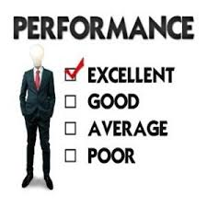
1. Job performance

Slide 37
Job satisfaction and job performance
Early belief was that happy workers are productive workers
Some researchers feel that it is an illusion for two reasons
When we do a good job, we feel good intrinsically
Besides high productivity results in greater economic, sociological and psychological rewards in the form of pay raise, greater recognition, promotion etc. This in turn increases our job satisfaction.
Studies have found that there is a strong positive correlation between job satisfaction and productivity

Slide 38
2. Organisational citizenship behaviour

Slide 39
Job satisfaction and OCB
Factors influencing OCB
Employees with job satisfaction are likely to engage in OCB
OCB is behaviour that goes beyond what is expected by the organisation
Perception of fairness- refers to the employees’ feelings that the organisation is fair to them with regard to its outcomes, procedures and treatment
Good relationship with coworkers
Individuals with certain personality traits are more happy at work

Slide 40
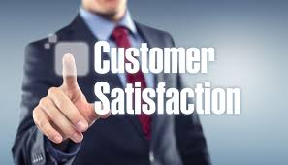
3. Customer satisfaction

Slide 41
Job satisfaction and customer satisfaction
High job satisfaction leads to an increase in customer satisfaction and loyalty
Satisfied employees are more friendly to the customers
Dissatisfied customers affect employee satisfaction- they are abusive and rude
Measures that organisations have taken to improve customer satisfaction
Training employees
Rewarding employees
Creating a positive work environment
Conducting regular employee satisfaction surveys

Slide 42
4. Absenteeism

Slide 43
Job satisfaction and absenteeism
Negative correlation between job satisfaction and absenteeism
Satisfied workers report more regularly to work
Some organisations have liberal leave policies allowing employees to pursue their passions
Absenteeism levels are high when employees have alternative jobs

Slide 44
5. Employee turnover

Slide 45
Job satisfaction and employee turnover
Factors that influence employee turnover
Employee turnover is the rate at which people leave an organisation
There is a negative correlation between satisfaction and turn over
Employment opportunities: when there are alternative employment opportunities they leave
Human capital: employees who are high in education and ability are more likely to quit.

Slide 46
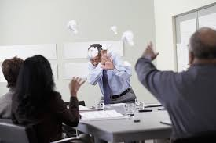
6. Work place deviance

Slide 47
Job satisfaction and work place deviance
Dissatisfaction is the root cause of deviant behaviours
It is also known as employee withdrawal behaviours
Different forms of deviant behaviour
Reporting late to work
Damaging company property
Surfing on the internet during work hours
Hostility to co workers
Theft in the form of stealing company stationary
Substance abuse
Reasons for deviant behaviour
The feeling that they are exploited
The feeling that they are being overworked and not adequately compensated
Frustration because of the cold treatment given by the organisation
The supervisor is ill treating them and using them as tools to attain organisational objectives
Employee deviant behaviours are employees’ ways of taking revenge, manager must pay attention to the cause of the deviant behaviour

Slide 48
In a nutshell,
What is attitude?
Components of attitude
Major job related attitudes
Job involvement
Organisational commitment
Perceived organisational support
Employee engagement
Job satisfaction- measurement-determinants-impact of job satisfaction on other variables

Slide 49
Thank you

